Slide 1
Python GUI Calculator Project
Python GUI Calculator Project

Slide 2
Development of a Graphical User Interface (GUI) Calculator
Building a Basic Calculator using Python, Tkinter, and VS Code IDEBuilding a Basic Calculator using Python, Tkinter, and VS Code IDE
Presenter Name: [Roshani Mor]
Date: June 2026

Slide 3
Project Overview & Objectives
Core Objective: Create a fully functional, visually appealing desktop calculator application.
Development Environment: Developed completely within Visual Studio Code (VS Code) utilizing the native Python extension environment.
Key Design Targets:
Implement an intuitive, easy-to-use grid layout.
Incorporate an advanced "groove-styled" 3D calculation screen.
Maintain robust error handling for common mathematical faults.

Slide 4

Technical Stack & Tools Used
Python Language: The core engine handling data processing and mathematical calculations.
Tkinter Library: Python’s standard built-in GUI toolkit used to construct the windows, buttons, and display labels without external dependencies.
VS Code IDE: The integrated workspace used for writing code, fixing indentations, and running scripts natively through the terminal.

Slide 5
Key Code Features Explained
Dynamic Equation Tracking: Uses a global string variable (equation_text) inside the button_press function to dynamically append button values as the user clicks them.
The Safe Evaluation Engine: Uses the eval() function wrapped inside a safe try...except block within the equals function.
Robust Error Handling:
Catches SyntaxError (e.g., if a user types ++) and outputs "Syntax Error".
Catches ZeroDivisionError (e.g., trying to divide by 0) and outputs "Arithmetic Error" instead of crashing.

Slide 6
User Interface (UI) Highlights
Right-Aligned Text (anchor="e"): Numbers line up nicely on the right side of the screen, mimicking real calculator behavior.
3D Grooved Display (relief="groove"): Features a distinct, etched 3D structural outline framing the display screen with a custom border width (bd=4).
Interactive Button Styling: Includes uniform button grids with clean text padding and a high-contrast visual layout.

Slide 7
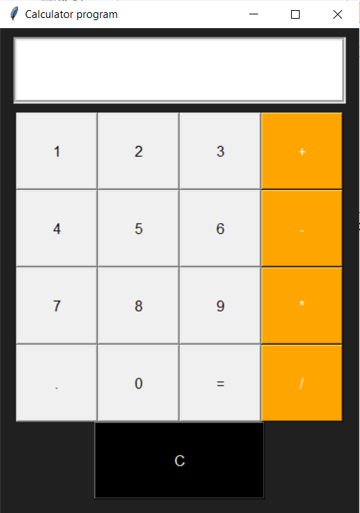
Application Output & Execution
How it runs in VS Code:
The project is saved as calculator.py inside the workspace
Clicking the Play Button ▶ compiles the script
Control your expressions
The local system opens the graphical window independently while maintaining a live debug log in the VS Code terminal below.

Slide 8
Conclusion & Future Scope
Project Summary: Successfully transitioned from a text-based terminal program to a fully interactive desktop utility.
Future Enhancements:
Mapping keyboard numpad buttons directly to the calculator.
Can add advanced scientific functions (square roots, percentages, and exponents)
Upgrade to the modern custom kinter theme pack for native dark-mode styling.
Know your material in advance

Slide 9

THANK YOU
Roshani Mor
8356989375
| linkedin.com/in/roshani-mor-50013a34a |
Rosh-l-m

